Slide 1
2019 Delran municipal budget
Delran Township | Burlington County
900 Chester Avenue
Delran, NJ 08075
www.DelranTownship.org

Slide 2
The next five pages of this report explain the budget process and provide the fundamentals of tax calculation

Slide 3
Delran Township Budget Process
The various department heads received their departmental budget request forms October of 2018 with instructions to submit in mid November.
The departmental budget requests were compiled along with the various budget categories that do not have a department head overseeing them (such as salaries, all forms of health insurance, liability insurance, pensions, utilities, landfill and trash estimates and put into a spread sheet)
The Mayor met with various department heads to review their requests in late December and early January in order to make recommendations to the Township Council in regard to a proposed appropriations budget.

Slide 4
Delran Township Budget Process
Township Council was provided on February 26th with the requests in the form of an excel spread sheet that also is tied into the appropriations portions of the budget in the Edmunds municipal software package. In addition, the Township Council has been provided with the supporting documentation to provide the computations and justifications for those budget numbers.
Township Council was provided on February 26th with a summary sheet that provides a picture of the where the Township budget is in regard to tax rate etc. given the previous years utilization of fund balance and revenues.
Township Council reviewed the budget at work sessions on March 12 and 26 and introduced the budget on April 2, 2019. There will be a public hearing on the budget on May 7th 2019 and plan to adopt the budget on that date.

Slide 5
The Big Picture - Net Valuation Taxable
Delran has a Net Valuation Taxable of $1,415,853,382.
This is the total valuation of all properties within the Township of Delran that are subject to property taxes.
What this also tells you as a Council person that each penny of the tax rate is worth $141,585.
So when Council reviews the appropriations portion of the budget and are making financial decisions during the year recognize that each $141,585 represents one cent on the tax rate.

Slide 6
The Big Picture - Tax Rate impact on Tax Payers
The next big picture question often asked is “what is the impact of an increase or decrease on the average residential tax payer.
From the Tax Collectors book there are 5,161 homes in Delran with a total valuation of $1,090,679,200 for an average assessment of $211,330 per home in Delran.
Based upon this information each penny in taxes cost the average homeowner $21.13 per year, since the tax rate is per thousand of the assessment.

Slide 7
Delran Municipal Tax rate in 2018
Utilizing last years tax rate and this years average assessment the average home in Delran paid $1,631 for the municipal tax rate and $48.60 for the open space tax.
These are the only funds that the Township of Delran keeps from the property tax bill. The rest of the funds have to be paid out to the School, the County and the Fire District.

Slide 8
Delran Municipal Tax Rate since 2014
The 2019 Budget will be the 7th budget that has been approved including the 2013. So, lets take a look back at how we have done in regard to the municipal budgets
The Tax Rate in 2013 was .756 Cents the Tax Rate 6 years later was .791 cents
So for the last seven years the total increase in the Municipal Tax Rate has been 3.5 cents
So for the last six years the Municipal Tax Increase in the average home has been $73.90.
Remember that the Municipal Rate represents just 21.9 percent of the total property tax bill in Delran.

Slide 9
2019 Budget Snapshot
The 2019 Municipal Budget is $17,713,671.05 this is an increase of $164,050.51 over last year, less than a 1 % increase.
The tax increase is 1.9 cents or a 2.46% increase. This will result in an increase of $40.15 for the year on the average home in Delran Township.
The average assessment is $211,330.

Slide 10
Comparative Tax Rate Summary | Last 9 Years
2011 | 2012 | 2013 | 2014 | 2015 | 2016 | 2017 | 2018 | 2019 | 8 year total
.745 | .745 | .756 | .756 | .766 | .764 | .761 | .772 | .791 | 4.6 cent increase
 | No Increase | 1.1 Cent Increase | No Increase | 1 cent increase | Slight Decrease (.002) | Slight Decrease (.003) | 1 cent increase | 1.9 cent increase | 4.6 cent increase Over 9 Budgets

Slide 11
The Township Council meetings are broadcast live on Livestream. The recordings and the live feed can be accessed through the DelranTownship.org web site.
TRANSPARENCY

Slide 12
9 Year History - Amount Raised by Taxation
2011 | 2012 | 2013 | 2014 | 2015 | 2016 | 2017 | 2018 | 2019
$10,704,500 | $10,500,000 | $10,649,000 | $10,610,000 | $10,722,000 | $10,721,788 | $10,713,000 | 10,902,313 | $11,201,613

Slide 13
2018 Tax Bill (Based upon average assessment of $211,000)

Slide 14
Analysis of Fund Balance
Year | Balance | Utilized in Next Budget | Percent Utilized | Percentage of Budget
2007 | $2,906,792 | $2,300,000 | 79% | 15.9%
2008 | $2,935,004 | $2,255,000 | 77% | 15%
2009 | $3,681,830 | $2,280,000 | 62% | 14.8%
2010 | $4,035,352 | $2,480,000 | 61% | 16%
2011 | $4,404,069 | $2,500,000 | 57% | 15.9%
2012 | $5,275,000 | $2,700,000 | 51% | 17.5%
2013 | $5,107,195 | $2,700,000 | 53% | 17.2%
2014 | $5,657,785 | $2,700,000 | 48% | 17.2%
2015 | $6,813,244 | $2,560,000 | 38% | 16.4%
2016 | $8,007,985 | $3,000,000 | 37.5% | 18%
2017 | $8,700,000 | $3,500,000 | 40% | 21%
2018 | $8,737,686 | $3,748,000 | 43% | 21%
2019 | $9,285,157 | $3,968,000 | 43% | 22%

Slide 15
Delran Public Works Department
Leaf Removal Program
Over the last three years, Delran has been converting leaf collection crews to one arm collectors. (Pictured above)
Now, we collect leaves faster with one man crews than with a three man operation. Leaves picked up faster, more efficiently and at reduced costs to the taxpayers.
The public works department collected and recycled 5,946 tons of leaves and collected 421 tons of brush during the past year.

Slide 16
Declining State Revenues

Slide 17
Recently refurbished Conrow Park
The Township recently completed a renovation of the Conrow Park playground with equipment purchased through a national contract at a lower cost than the traditional purchasing procedures.
Improvements to the park included replacing equipment, replacing mulch in fall zones, trimming trees and introduced the first playground with an interactive app that can be accessed by cell phone.
Games can be played on the playground with the augmented reality markers that are installed: markers can unlock new content, activate mini-games and reveal treasures when scanned.

Slide 18
Budget Revenue Summary
 | 1990 | 1995 | 2005 | 2011 | 2012 | 2013 | 2014 | 2015 | 2016 | 2017 | 2018 | 2019
Local Revenue | 81% | 76% | 82% | 91% | 91% | 92% | 92% | 92% | 91.7% | 92.4% | 92.7% | 92.8%
State Revenue | 19% | 24% | 18% | 9% | 9% | 8% | 8% | 8% | 8.3% | 7.6% | 7.3% | 7.2%

Slide 19
Delran police Department
In 2018, the Delran Police Department received re-accreditation through the New Jersey State Chiefs of Police Accreditation program. The department initially received accreditation in 2011 and must undergo a reassessment every three years to remain accredited.
Accredited status represents a significant professional achievement. Accreditation is the certification by an independent reviewing authority that a law enforcement agency has met specific requirements and prescribed standards.
Accreditation reflects that the Accredited Agency was carefully measured against an established set of state and national standards and has met or exceeded accepted practices in the field of law enforcement. Research shows that accredited agencies have 11% fewer police professional liability claims, 18% fewer workers compensation claims and 31% fewer auto liability claims.
Moreover, municipalities that participate in a MEL-affiliated Joint Insurance Fund stand to receive substantial insurance premium discounts when their police department attains Accreditation

Slide 20
Percentage of Tax Collections
Year | % Collected
2008 | 98.90
2009 | 98.50
2010 | 98.63
2011 | 98.79
2012 | 98.67
2013 | 98.69
2014 | 98.94
2015 | 98.58
2016 | 98.55
2017 | 98.49
2018 | 98.72
2019 | 98.69

Slide 21
General Revenues
Surplus Anticipated 3,968,000
Local Revenues 879,100
State and Federal Aid 1,364,958
Receipts –Delinquent Taxes 300,000
Amount Raised by Taxation 11,201,613
Total $17,713,671

Slide 22
Township Events / Easter Egg Hunt
The Mayor, Council and the Recreation Advisory Committee host a number of events in 2019 including the Easter Egg Hunt, Winterfest and Delran Night Out with Fireworks.

Slide 23
Revenues by Category

Slide 24
Chart of 9 Year Spending by Category

Slide 25
The sewer department maintains approximately 74 miles of sanitary sewer which 75% is gravity and 25% is force mains. The Department maintains these lines by routinely cleaning via high pressure jetting and vacuuming out debris. They also have a schedule of known trouble areas that are inspected and cleaned more frequently. They answer emergency calls from residents with sewer related issues and clear blockages in mains when they occur.
Delran Sewer Department

Slide 26
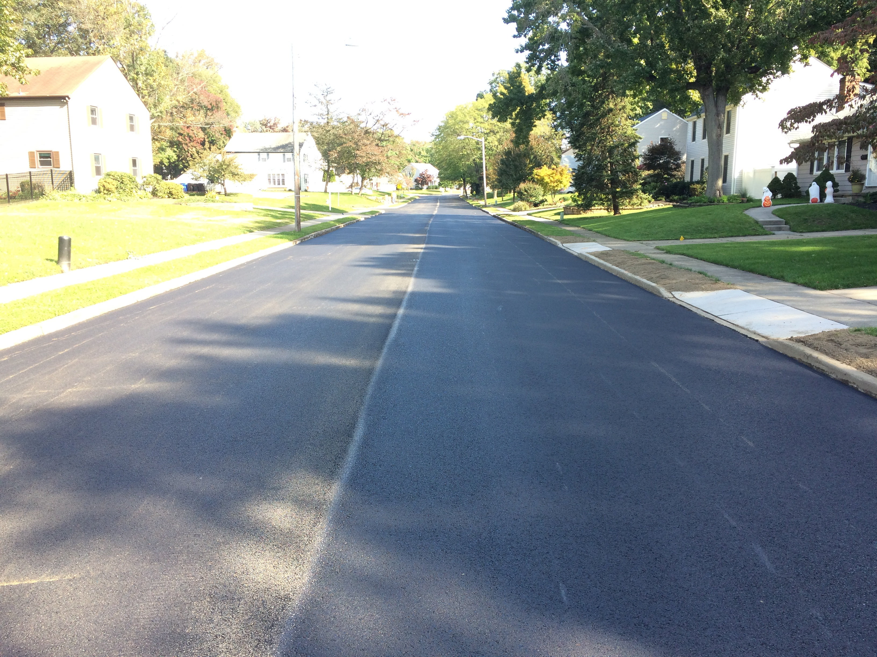
The Township continues with our aggressive road program in the 2019 budget. The pictures above are one of the roads from the 2018 Road Program. This year the Township will be put out to bid for improvement Diane Avenue, Patricia Avenue, River Drive, Norman Avenue, Lake and Wills Streets.
Delran Road Program
Windmoor/Before Resurfacing
Windmoor/After Resurfacing

Slide 27
Budget Appropriations

Slide 28
Total Appropriations
 | Total Appropriations | Change
2011 | $15,685,000
2012 | $15,631,000 | - 54,000
2013 | $15,796,000 | +165,000
2014 | $15,735,543 | - 60,457
2015 | $15,584,900 | - 150,643
2016 | $16,593,217 | $743,939
2017 | $16,818,595 | $225,368
2018 | $17,500,000 | $681,405
2019 | $17,713,671 | $231,671

Slide 29
Delran Winter Festival
The Township, through the Recreation Advisory Commission, has most recently introduced the expanded Winter and looks forward to this years Delran Night Out that are included in this years budget.

Slide 30
7 Year Summary of Net Valuation Taxable
Year | Valuation | Difference
2012 | $1,409,575,370 | -$155,440,681 (reassessed)
2013 | $1,408,433,780 | -$1,142,000
2014 | $1,403,370,633 | -$5,063,147
2015 | $1,399,747,692 | -$3,622,941
2016 | $1,401,551,386 | +$1,803,694
2017 | $1,407,526,492 | + $5,975,106
2018 | $1,412,432,892 | + $4,906,400
2019 | $1,415,853,382 | +4,198,200

Slide 31
Pie Chart of Tax by Entity (Total Entity Tax for County - includes County, Library, and Open Space. Municipal includes Open Space) (Based on 2018 Tax Bill)

Slide 32
SNOW REMOVAL SERVICES (NOW INCLUDES BRINE APPLICATION)
The Township has recently expanded its snow removal services to include the application of brine to the roads when conditions are optimal.
The picture above is a road where brine was applied to the right side of the road and not applied to the left side which is still snow covered.
The 2019 budget provides for expanded brine services.

Slide 33
Total Tax Bill by Tax Entity (Based on 2018 Tax Bill)
County Tax .385
County Library Tax .034
County Open Space Tax .028
District School Tax 2.383
Municipal Open Space Tax .023
Local Municipal Tax .772
Fire District .15

Slide 34
The Township of Delran will be opening Jakes Place in 2019 year. It's an integrated play area in which all children, those who are able and those with disabilities, can play interactively. The objective is to design an area that is barrier-free, socially inviting, and contains play environment groupings. This park has been designed to incorporate themes that are relevant to our locale. This Park has been a multi-year effort in coordination with donations to Build Jakes Place, The Township of Delran and the County of Burlington. Come visit Jake’s Place.
Build Jake's place

Slide 35
Tax by Entity for Average Home (Estimate at $211,000) (2018 Tax Bill)
Entity | Tax
County Tax | $900.90
School Tax | $4,941.30
Municipal Tax | $1,646.40
Fire Tax | $329.70
Total | $7,818.30

